Slide 1
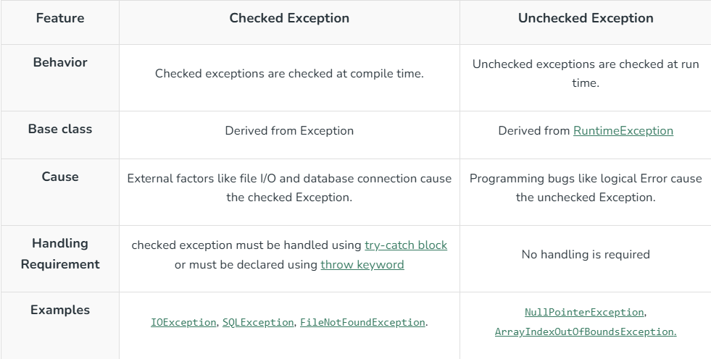
Difference Between Checked and Unchecked Exceptions

Slide 2
Categories of Checked Exceptions
Fully Checked Exception: These are exceptions in which all their subclasses are also checked. Examples include IOException and InterruptedException.
Partially Checked Exception: These exceptions have some subclasses that are unchecked. A common example is the Exception class.
Checked exceptions typically arise due to factors beyond the program’s direct control, such as issues related to memory, networking, or file handling. All checked exceptions are derived from the Exception class. Unlike unchecked exceptions, they must either be handled using a try-catch block or declared in the method signature using the throws keyword.
Unchecked Exceptions in Java
Unchecked exceptions are runtime exceptions that are not required to be caught or declared in a throws clause.
These exceptions are caused by programming errors, such as attempting to access an index out of bounds in an array or attempting to divide by zero.
Unchecked exceptions include all subclasses of the RuntimeException class, as well as the Error class and its subclasses.

Slide 3
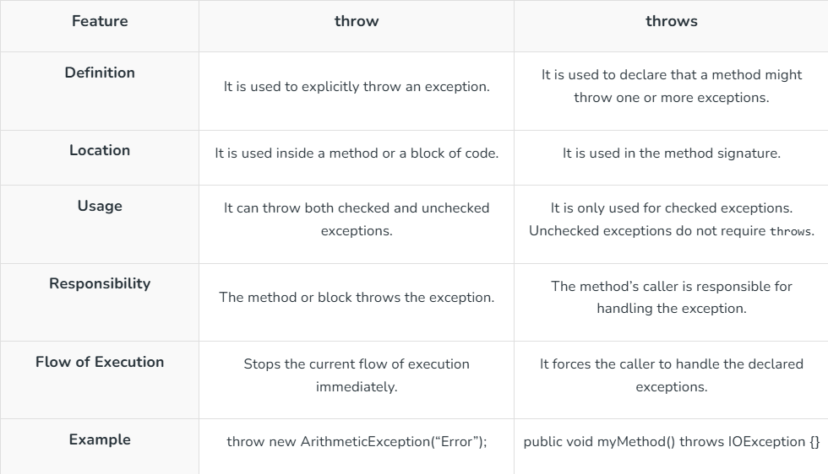
Difference Between throw and throws

Slide 4
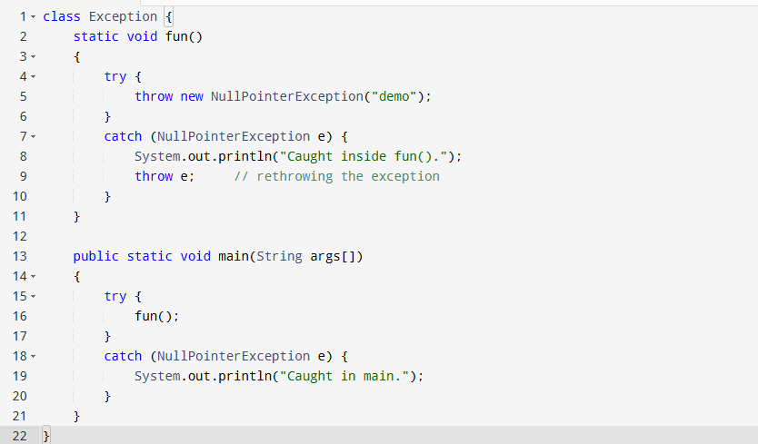

Slide 5
throws keyword is required only for checked exceptions and usage of the throws keyword for unchecked exceptions is meaningless.
throws keyword is required only to convince the compiler and usage of the throws keyword does not prevent abnormal termination of the program.
With the help of the throws keyword, we can provide information to the caller of the method about the exception.

Slide 6
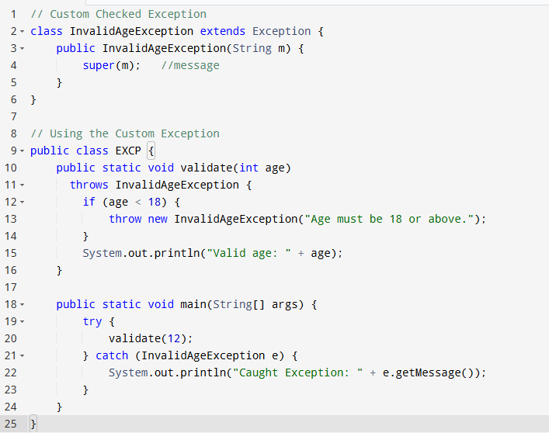
User-Defined Custom Exception in Java
Checked Custom Exception

Slide 7
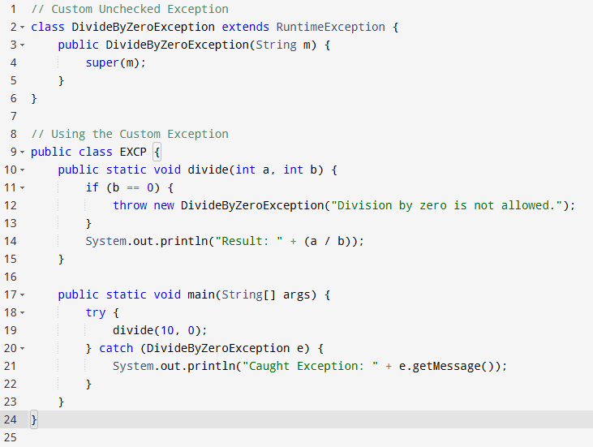
Unchecked Custom Exception

Slide 8
Chained Exceptions in Java
Chained Exceptions in Java enable linking one exception to another, allowing an exception to indicate the root cause of an error. For instance, if a method throws an ArithmeticException due to division by zero, but the actual issue stems from an I/O failure that resulted in a zero divisor, chained exceptions help convey both the immediate error and its underlying cause.
Advantages of Chained Exceptions
This exception helps in debugging by providing details about both primary and root causes.
It simplifies error handling by enabling propagation of complete exception context.
This improves traceability of errors in complex applications.

Slide 9
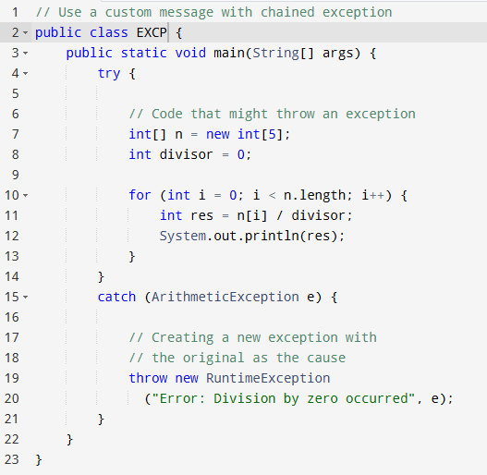

Slide 10
Null Pointer Exception in Java
Reasons for Null Pointer Exception
Invoking a method from a null object.
Accessing or modifying a null object’s field.
Taking the length of null, as if it were an array.
Accessing or modifying the slots of null objects, as if it were an array.
Throwing null, as if it were a Throwable value.
When you try to synchronize over a null object.
How to Avoid the NullPointerException?
To avoid the NullPointerException, we must ensure that all the objects are initialized properly, before we use them. When we declare a reference variable, we must verify that object is not null, before we request a method or a field from the objects.

Slide 11
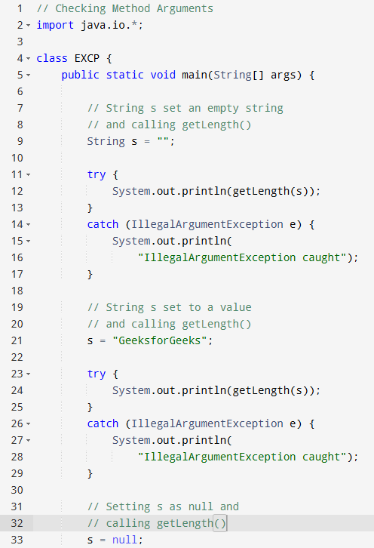
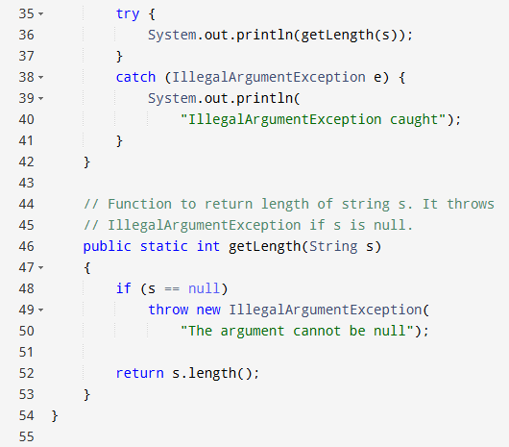

Slide 12
Exception Handling with Method Overriding in Java
In any object-oriented programming, method overriding allows a subclass to redefine a method from its superclass. With exception handling, the subclass can:
The subclass can throw the same or smaller exceptions.
It can choose not to throw any exceptions.
It cannot throw new checked exceptions not in the parent method.

Slide 13
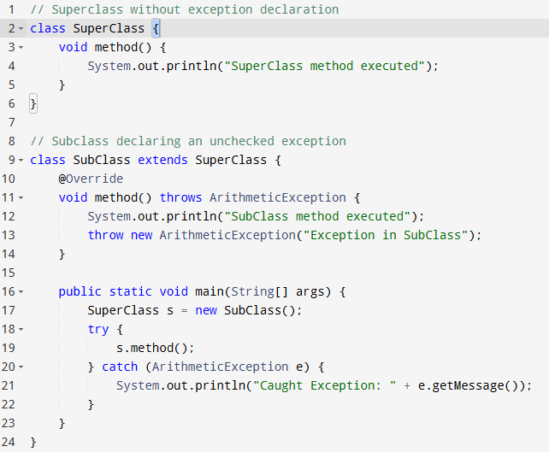

Slide 14
Scenario:
A new online movie ticket booking system is being developed. Users can book tickets for different movies based on seat availability. Each movie has a fixed number of seats, and once all seats are booked, no further reservations can be made. If a user tries to book a seat when none are available, the system should throw a SeatNotAvailableException.
You are required to implement this system using Java by:
Creating a Movie class to store the movie name and available seats.
Implementing a method bookTicket(int seats) to handle ticket booking and throw an exception if there aren’t enough seats.
Writing a custom exception class called SeatNotAvailableException.
Testing the functionality using a main method.

Slide 15
Scenario:
A university maintains a grading system where students receive grades based on their marks. The system should ensure that students enter valid marks (0 to 100). If a student enters marks outside this range, the system should throw an InvalidMarksException.
Your task is to implement this system using Java by:
Creating a Student class with attributes for name and marks.
Implementing a method assignGrade() that determines the grade based on marks.
Writing a custom exception class called InvalidMarksException.
Testing the functionality using a main method.

Slide 16
Scenario:
A bank provides an ATM withdrawal service where customers can withdraw money from their accounts. However, the ATM imposes two restrictions:
A user cannot withdraw more money than their account balance.
The withdrawal amount must be in multiples of 100 (e.g., 100, 200, 500, etc.).
If a user attempts to withdraw more than their balance, the system should throw an InsufficientFundsException. If a user tries to withdraw a non-multiple of 100, the system should throw an InvalidAmountException.
Your task is to implement this system in Java by:
Creating a BankAccount class with attributes for account number and balance.
Implementing a method withdraw(double amount) that validates and processes the withdrawal.
Writing two custom exception classes: InsufficientFundsException and InvalidAmountException.
Testing the functionality using a main method.

Slide 17
Scenario:
A flight booking system allows passengers to book seats on flights. However, if a flight is fully booked, the system should throw a NoSeatsAvailableException.
Your task is to implement this system in Java by:
Creating a Flight class to manage available seats.
Implementing a method bookSeat(int seats) that handles bookings and throws an exception if no seats are available.
Writing a custom exception class called NoSeatsAvailableException.
Testing the functionality using a main method.

Slide 18
Scenario:
A gaming company wants to develop a simple "Number Guessing Game" where the player tries to guess a randomly generated number within a limited number of attempts.
Game Rules:
The program generates a random number between 1 and 100.
The player has 5 attempts to guess the number.
After each guess, the program provides feedback:
  "Too High!" if the guess is greater than the number.
  "Too Low!" if the guess is smaller than the number.
  "Correct! You Win!" if the guess matches the number.
If the player fails to guess within 5 attempts, the game displays "Game Over! The number was X".

Slide 19
Scenario:
A game development company wants to create a simple Rock, Paper, Scissors game where a user plays against the computer.
Game Rules:
The player chooses one of the three options:
  Rock (✊)
  Paper (📄)
  Scissors (✂️)
The computer randomly selects one of the three options.
The winner is determined by the following rules:
  Rock beats Scissors (Rock crushes Scissors)
  Scissors beats Paper (Scissors cut Paper)
  Paper beats Rock (Paper wraps Rock)
  If both choices are the same, it's a tie.
The game should continue until the player chooses to quit.

